Slide 1
CSE 11 Accelerated Intro to Programming Lecture 8
Greg Miranda, Summer 1 2021
This lecture is being recorded

Slide 2
Announcements
PA4 due Sunday @ 11:59pm
PA0.5 and PA1 resubmissions due tonight @ 11:59pm
Quiz 3 due tonight @ 11:59pm
Quiz 4 released after class @ 11am
Due Sunday @ 11:59pm
Next week – no holidays!
Lectures go back to Monday through Thursday
My office hours will also be Monday through Thursday, 8am – 9am
Exam 1
Next Friday/Saturday
Details soon on Piazza

Slide 3
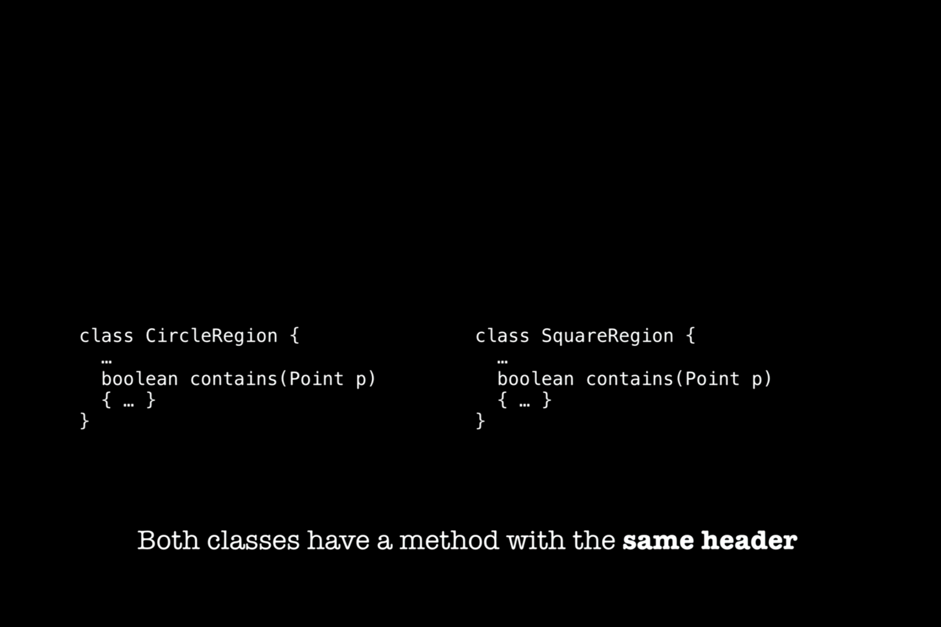

Slide 4
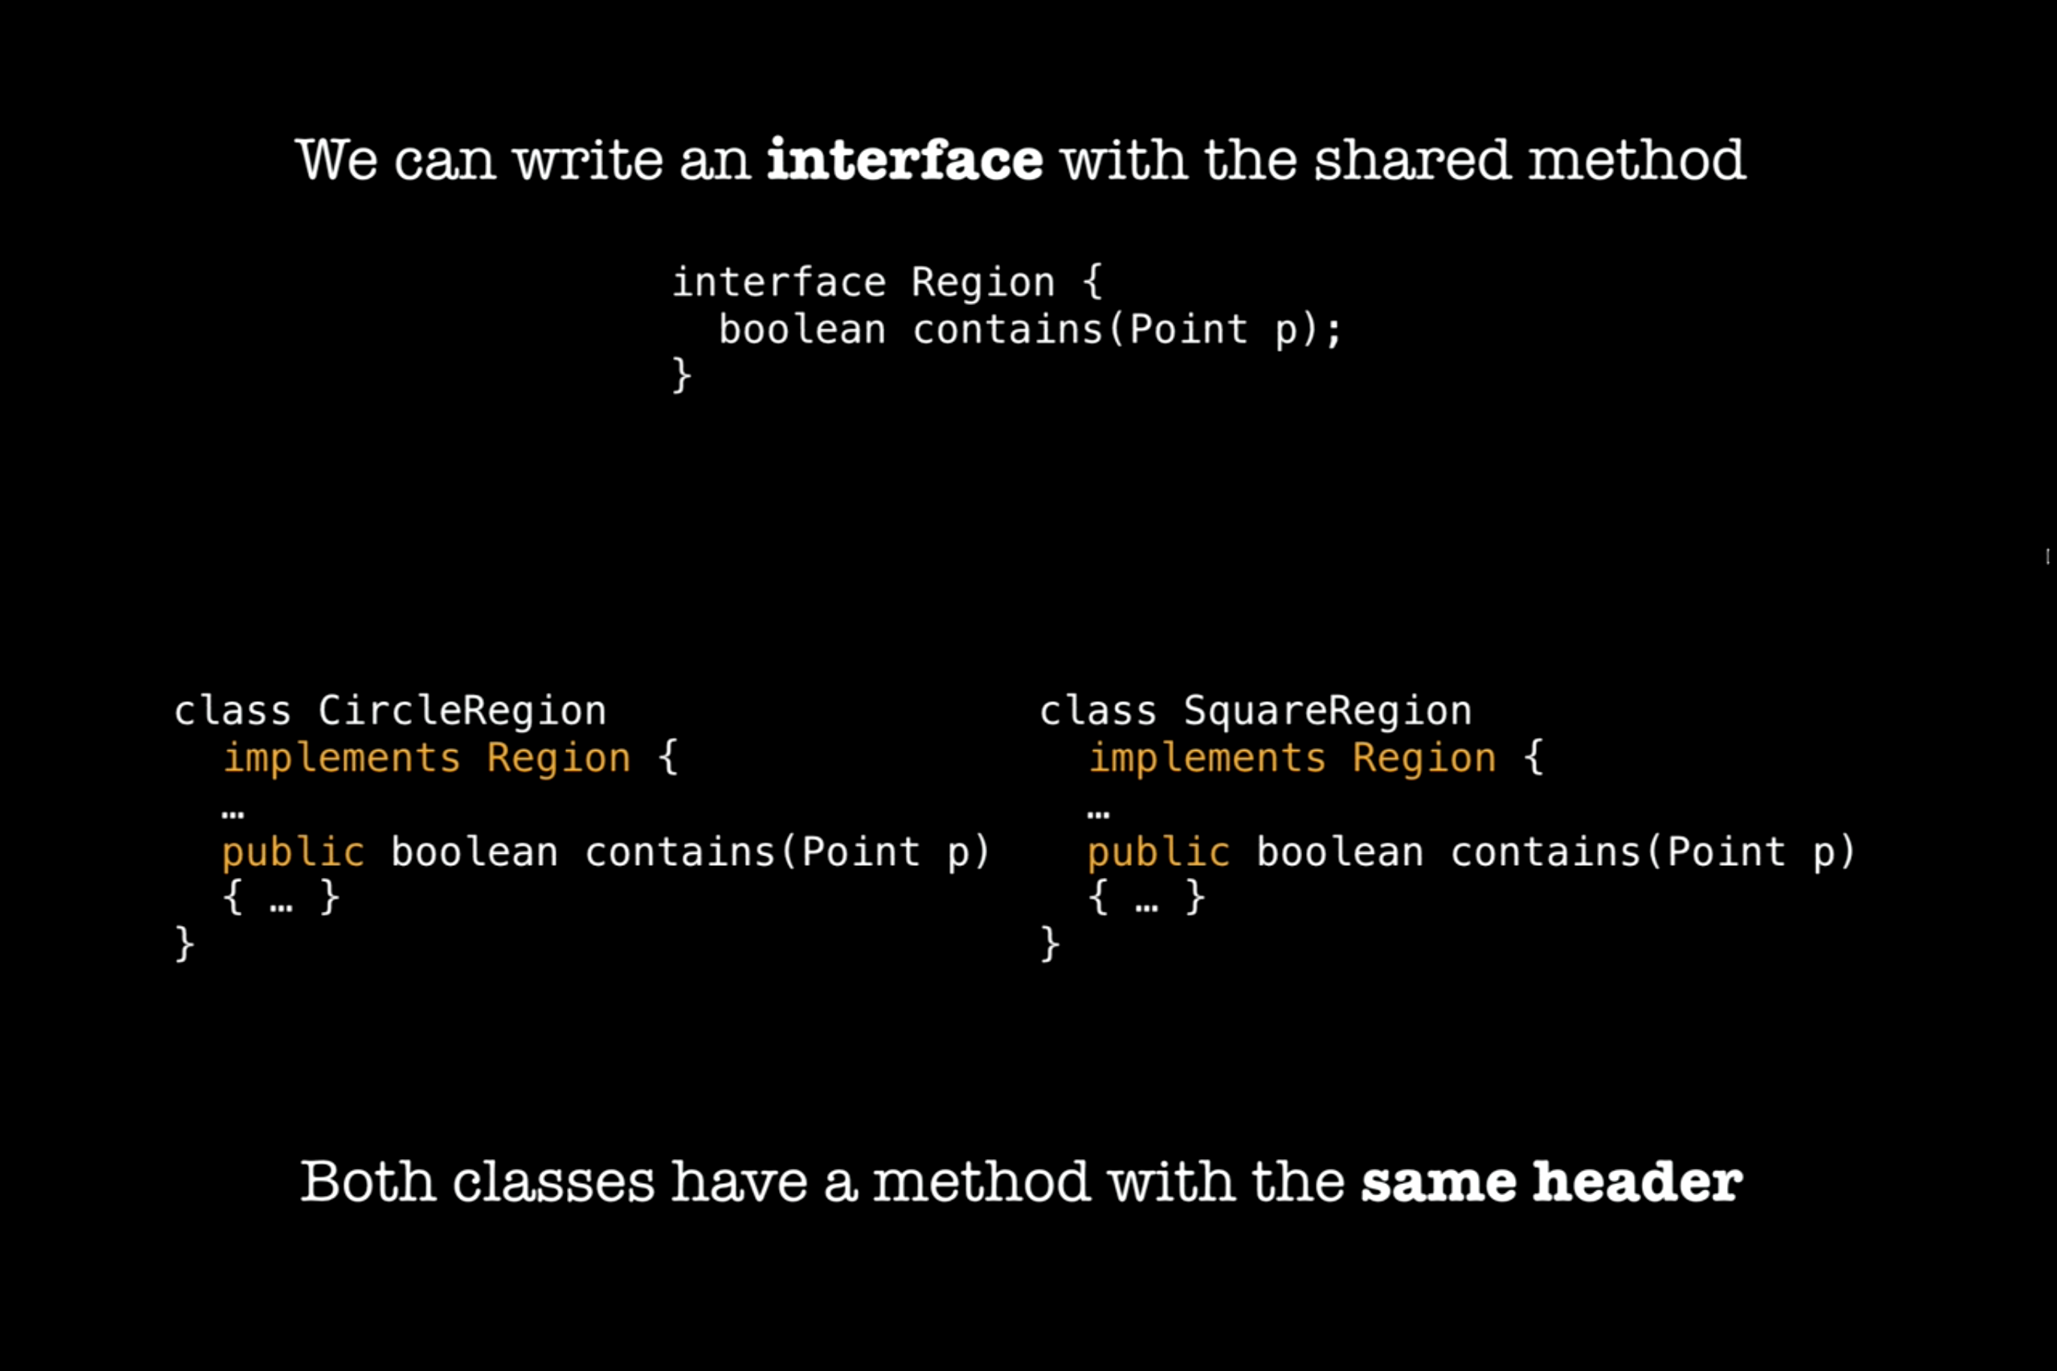

Slide 5
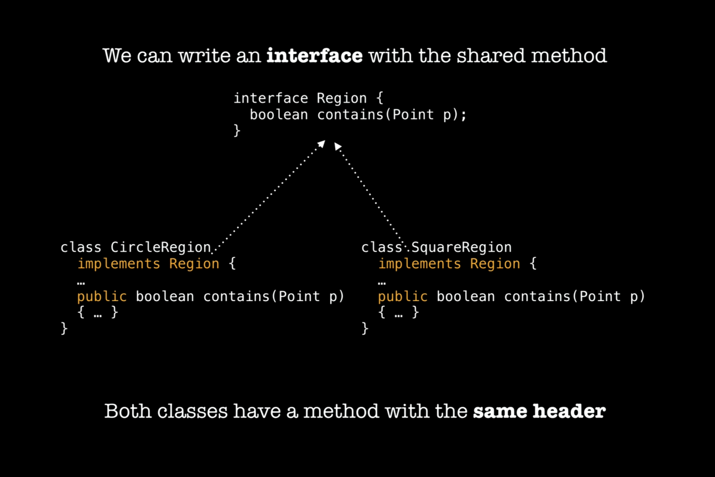

Slide 6
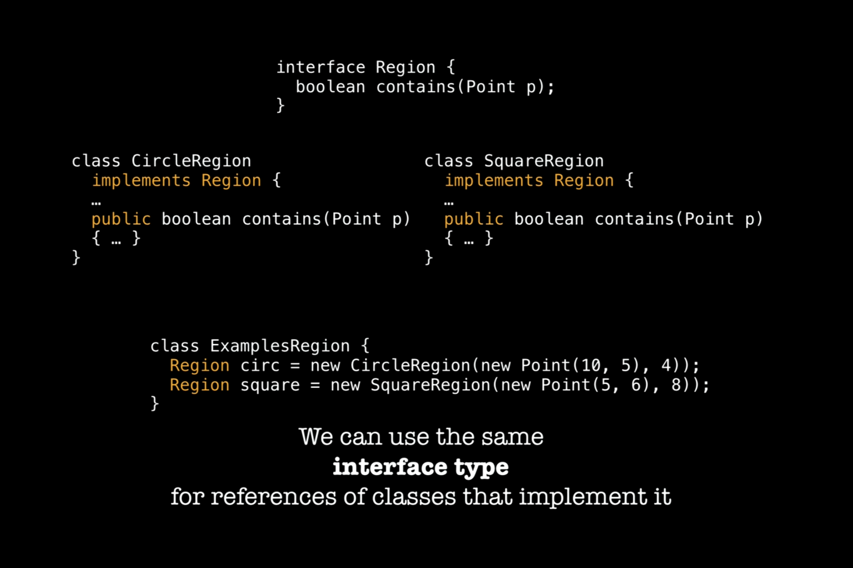

Slide 7
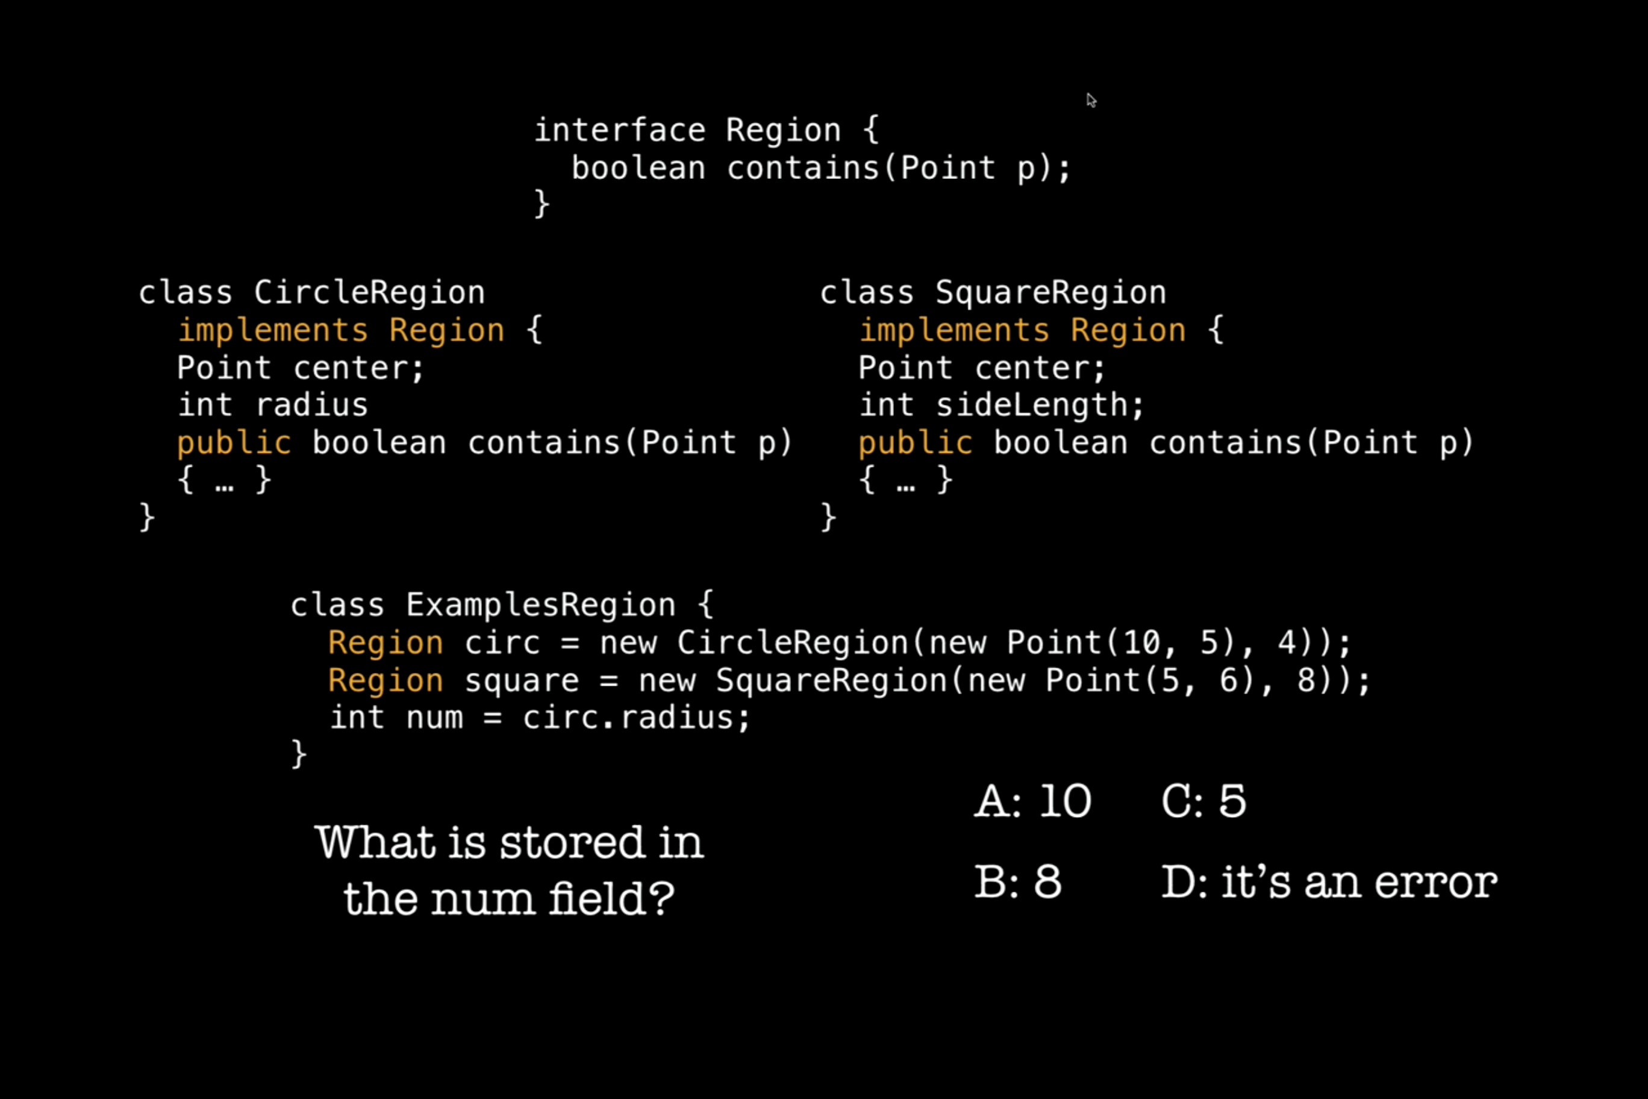






Slide 8
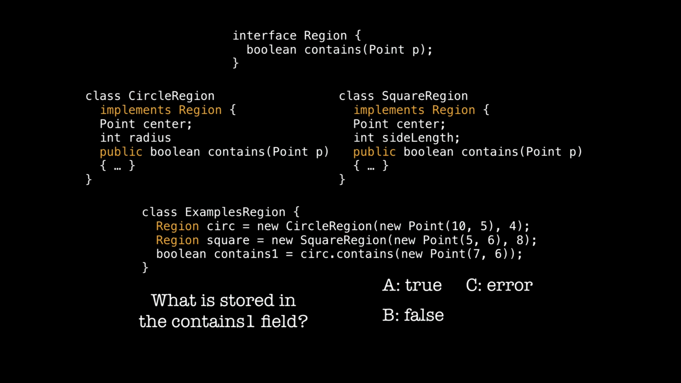




Slide 9
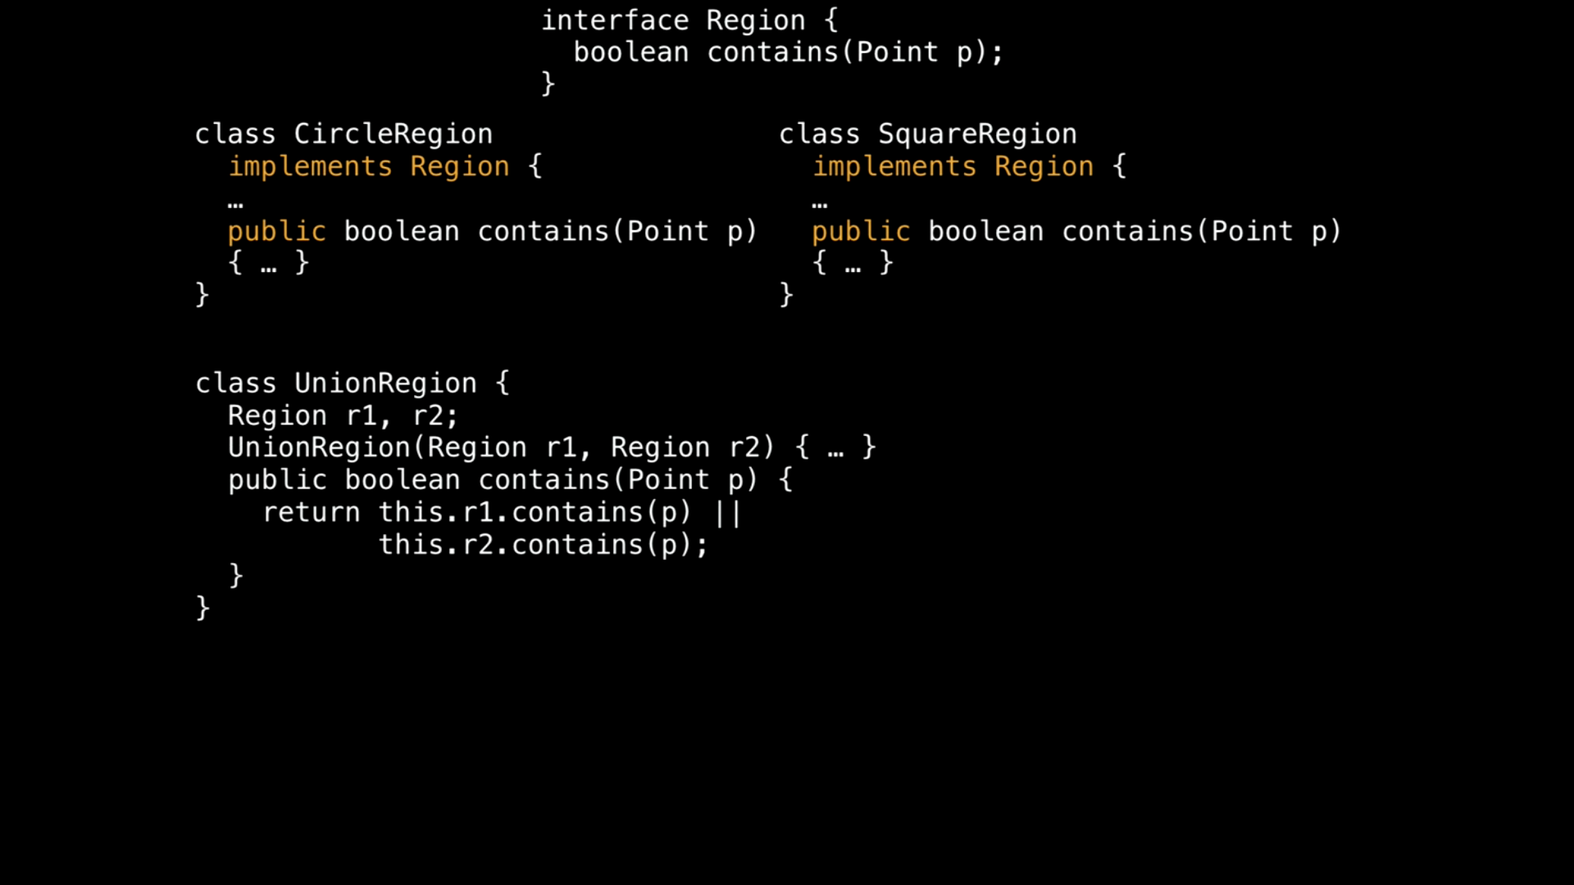






Slide 10
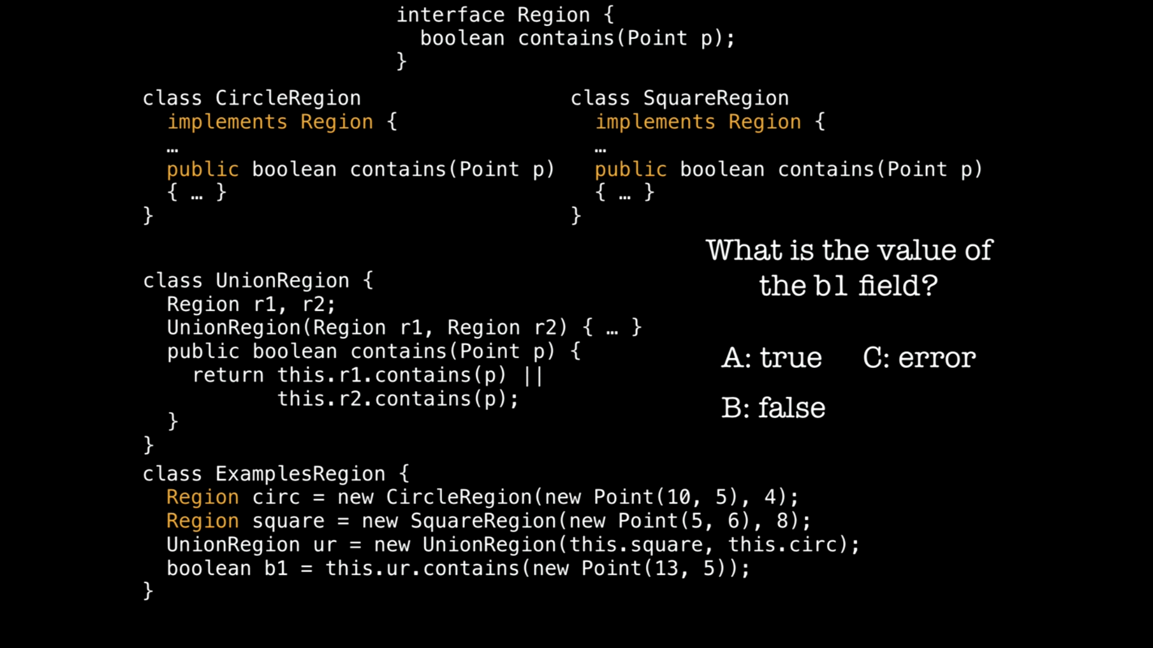




Slide 11
Using Interfaces
Add Region interface
Update RectRegion & CircRegion

Slide 12
Intersect Region
interface Region {
boolean contains(Point p);
}
class IntersectRegion implements Region {
Region r1;
Region r2;
IntersectRegion(Region r1, Region r2) {
this.r1 = r1;
this.r2 = r2;
}
public boolean contains(Point p) {
return this.r1.contains(p) && this.r2.contains(p);
}
}

Slide 13
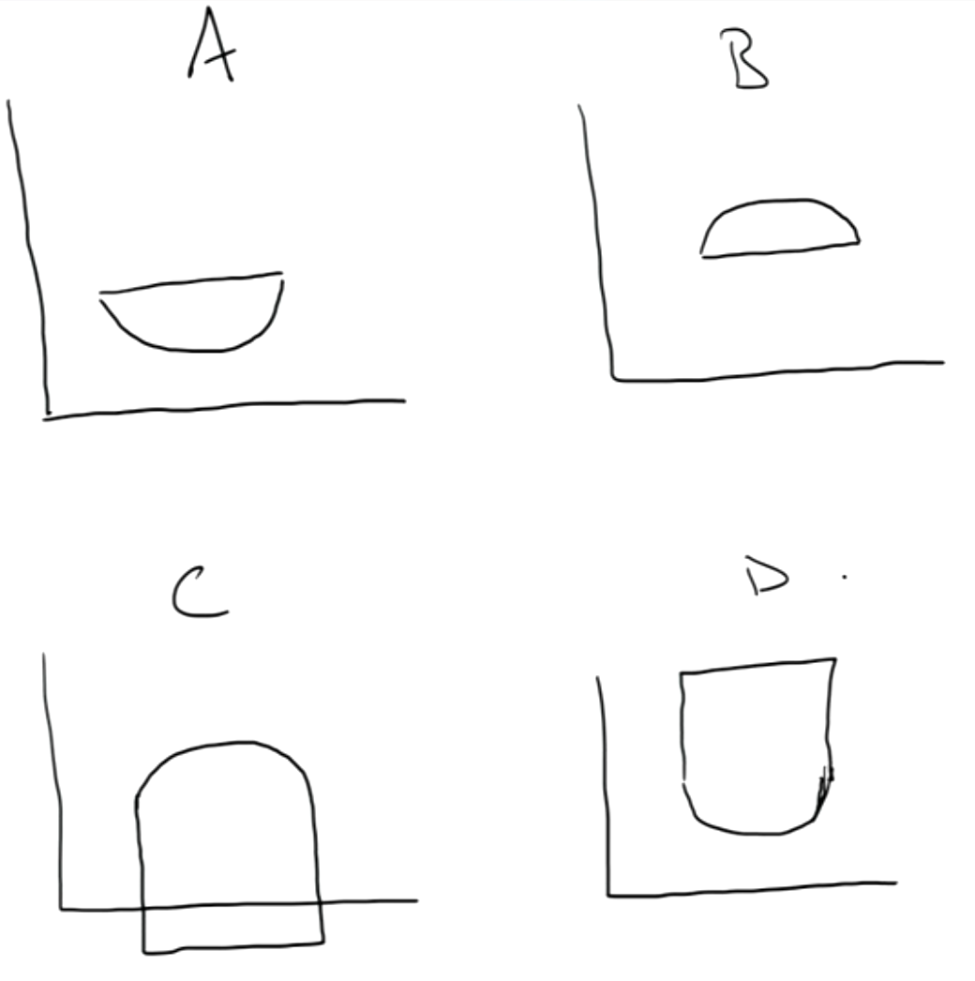

class IntersectRegion implements Region {
…
public boolean contains(Point p) {
return this.r1.contains(p) && this.r2.contains(p);
}
}
class ExamplesRegion {
Region circ1 = new CircleRegion(new Point(10, 5), 4.0);
Region sq = new SquareRegion(new Point(10, 1), 8.);
Region ir = new IntersectRegion(this.circ1, this.sq);
//What region is represented in toDraw?
Region toDraw = ir;
}

Slide 14

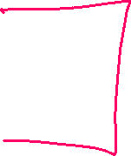






SubtractRegion
Write a new class called SubtractRegion
That also implements Region
Represents all the points in region1 that aren’t in region2
Start with a shape and subtract another shape from it
Subtract a circle from another circle to create a ring
Write the class
Fields and constructor
What does the contains method look like?

Slide 15




Something more complicated
What if we wanted a region that was 3 circles next to each other:
How could we construct an example of this?

Slide 16

Inheritance
New terms
abstract class
extends

Slide 17
Abstract Class Summary
Why did we introduce abstract classes?
Multiple classes had the exact same method
Same method header (same types)
Same implementation
add() method – put into all the region classes
Same implementation in all of them
Made an abstract class
Had one implementation of that method
Used extends so that all of the implementations could share that one method

Slide 18
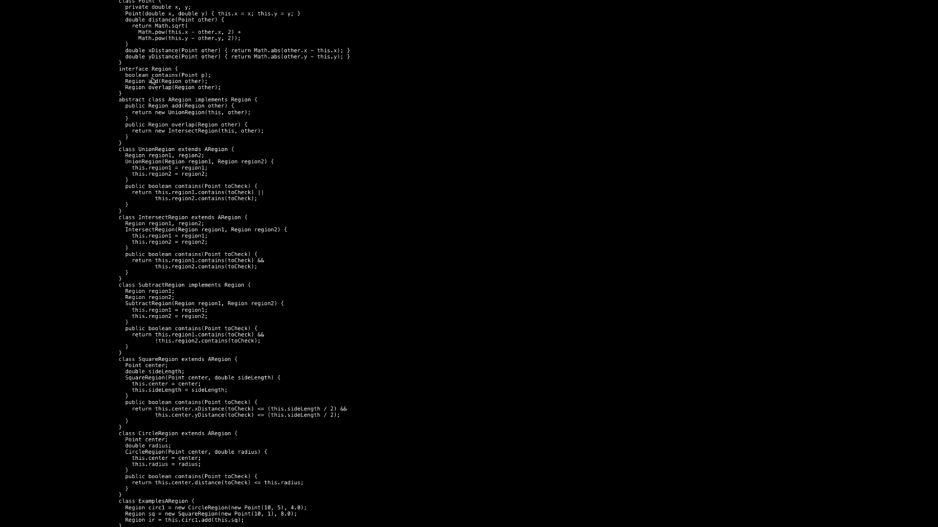

Slide 19
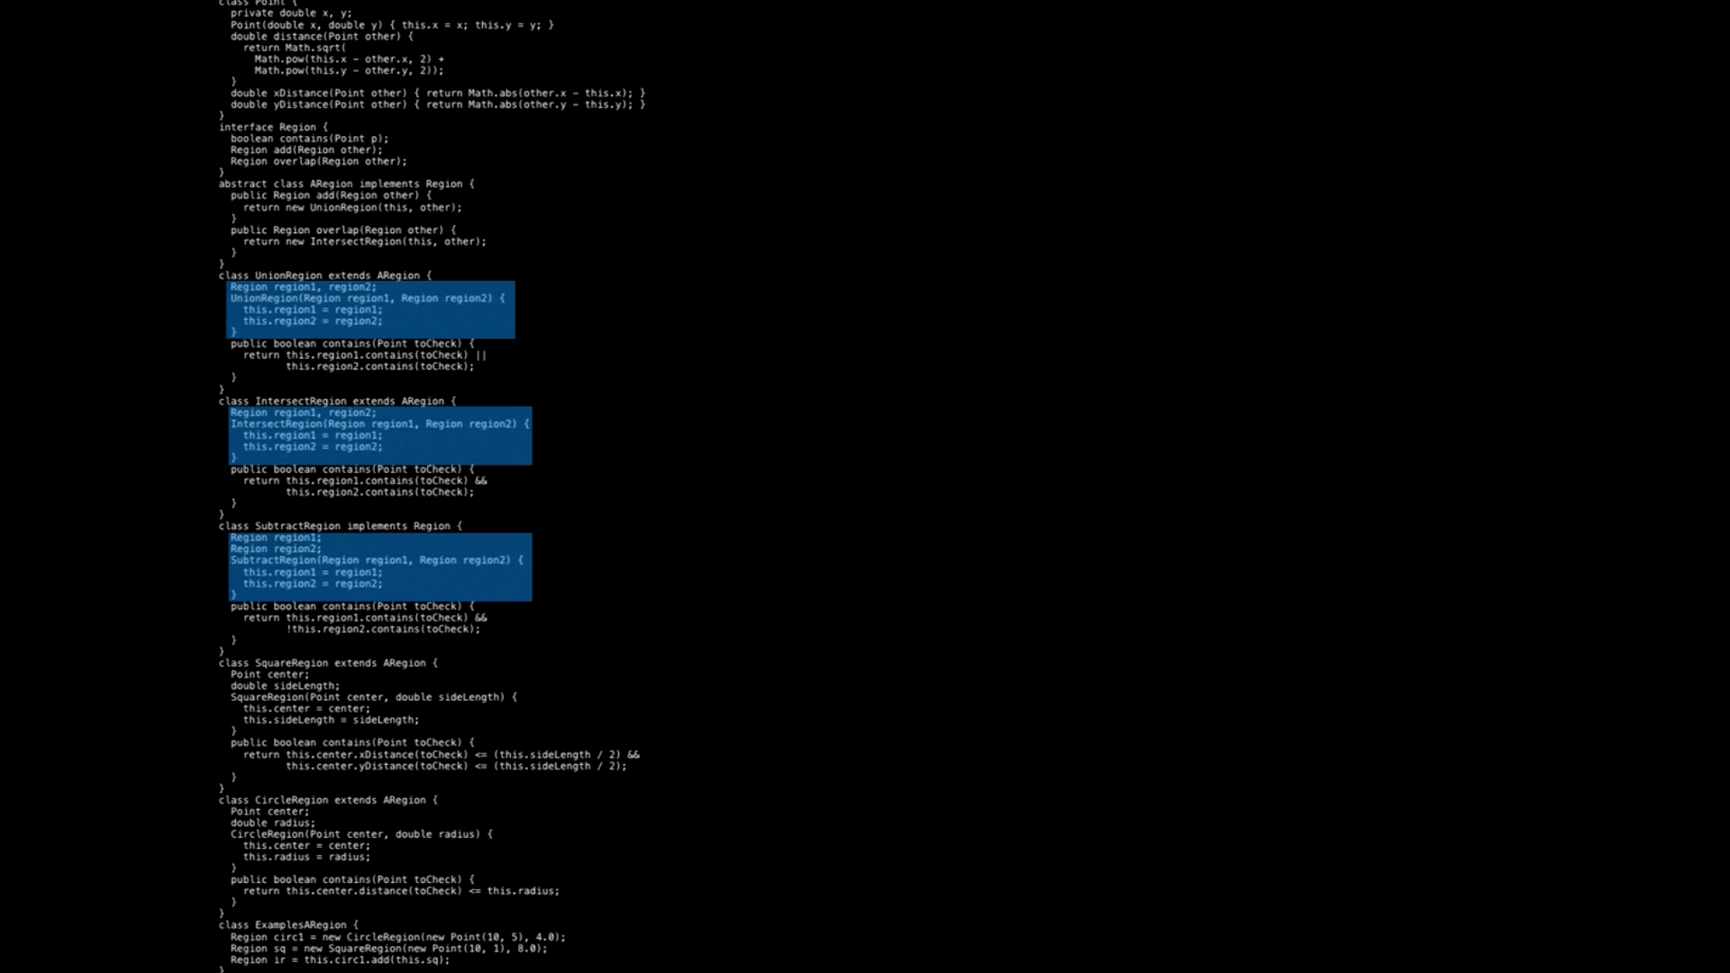

Slide 20
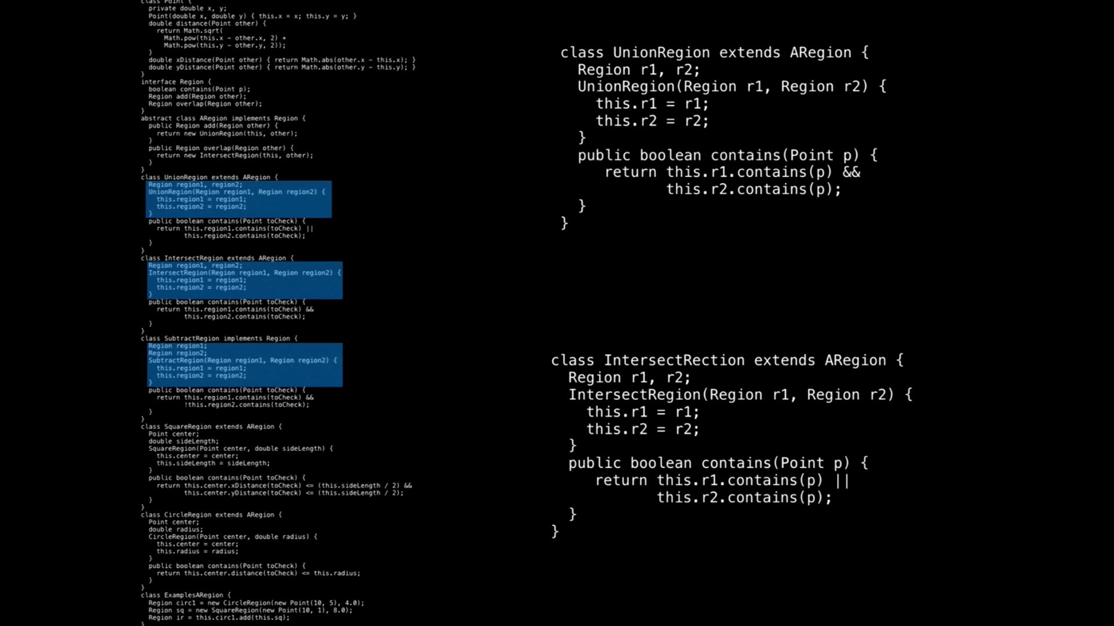

Slide 21
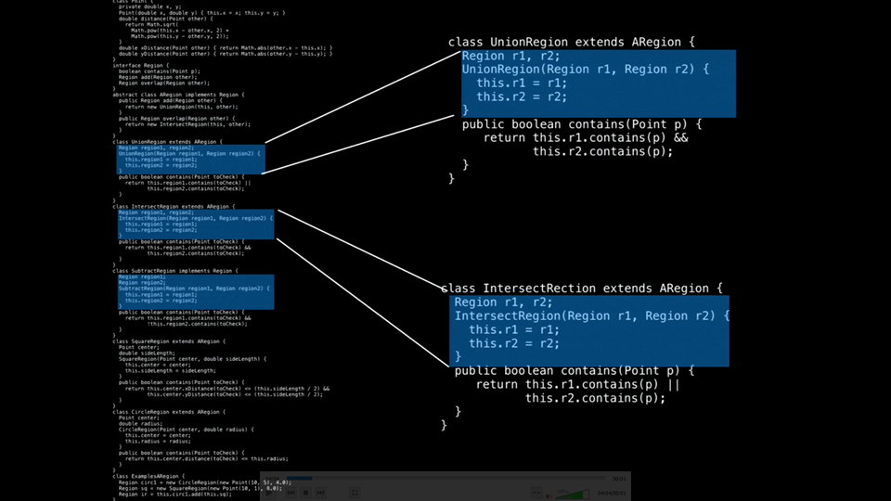

Slide 22
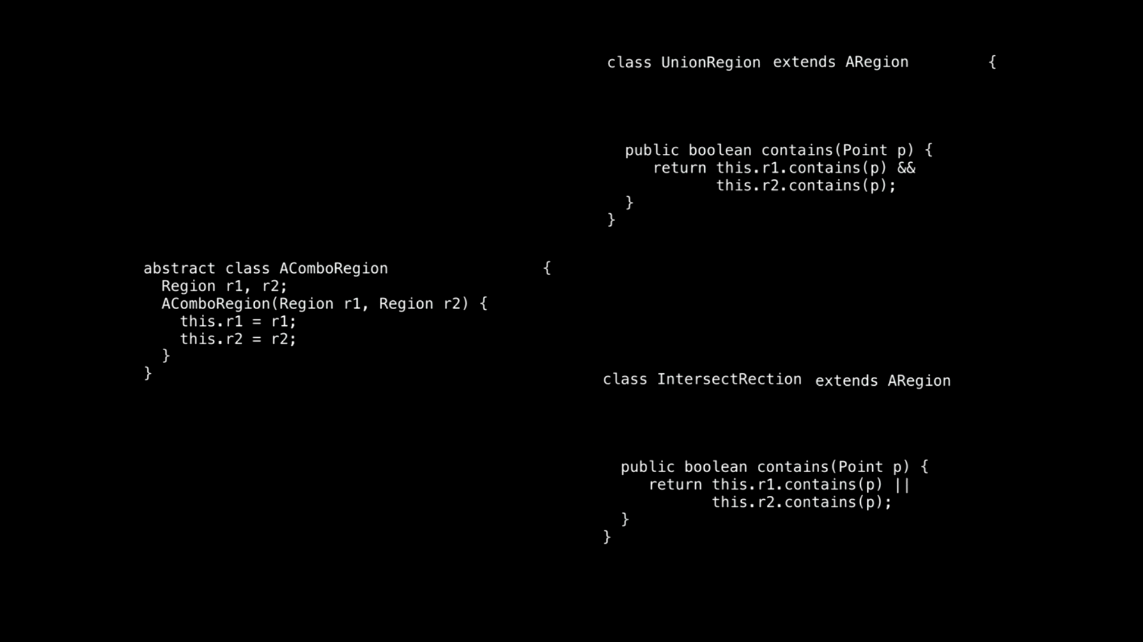

Slide 23
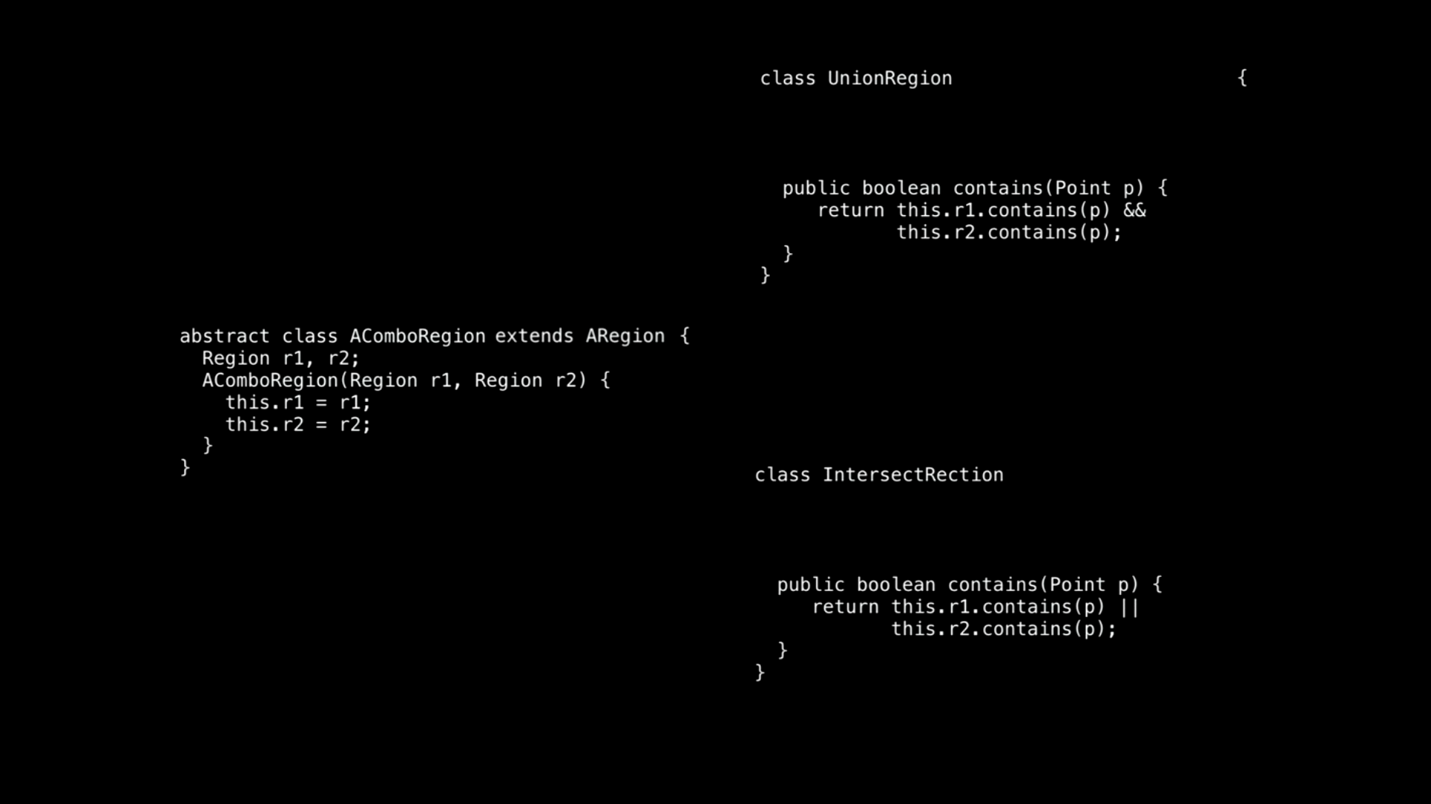

Slide 24
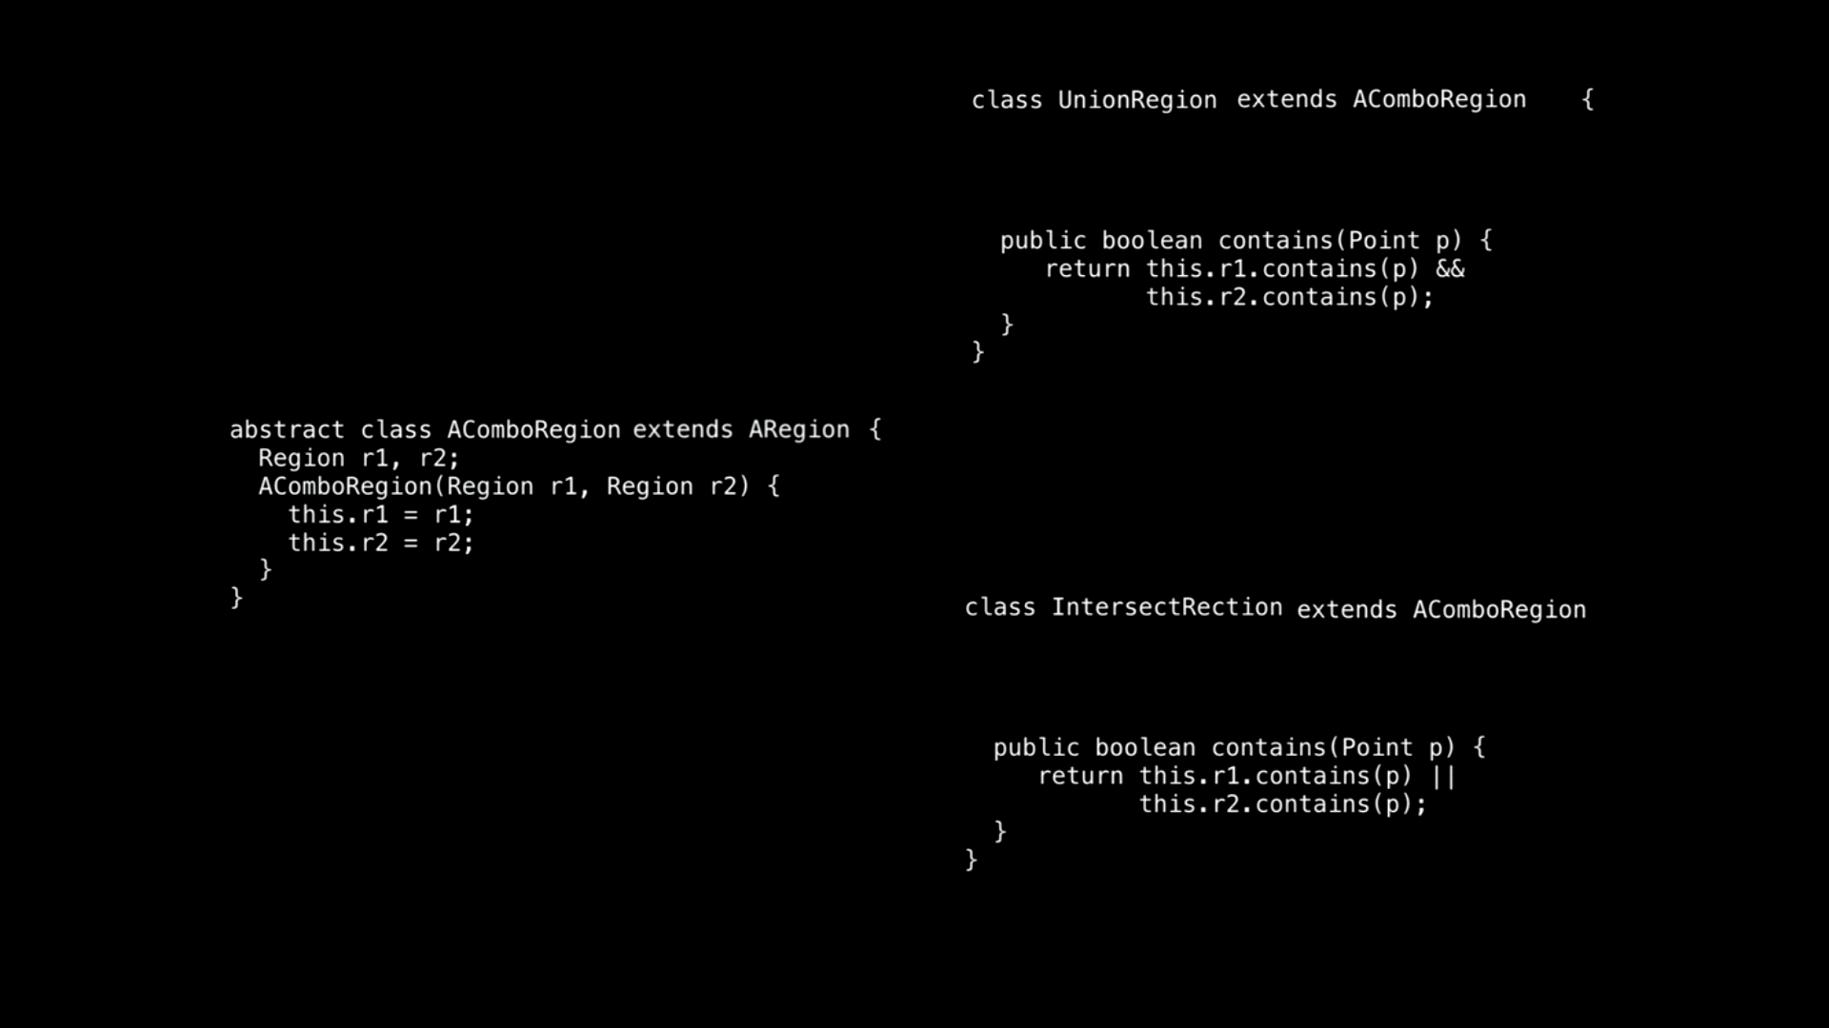

Slide 25
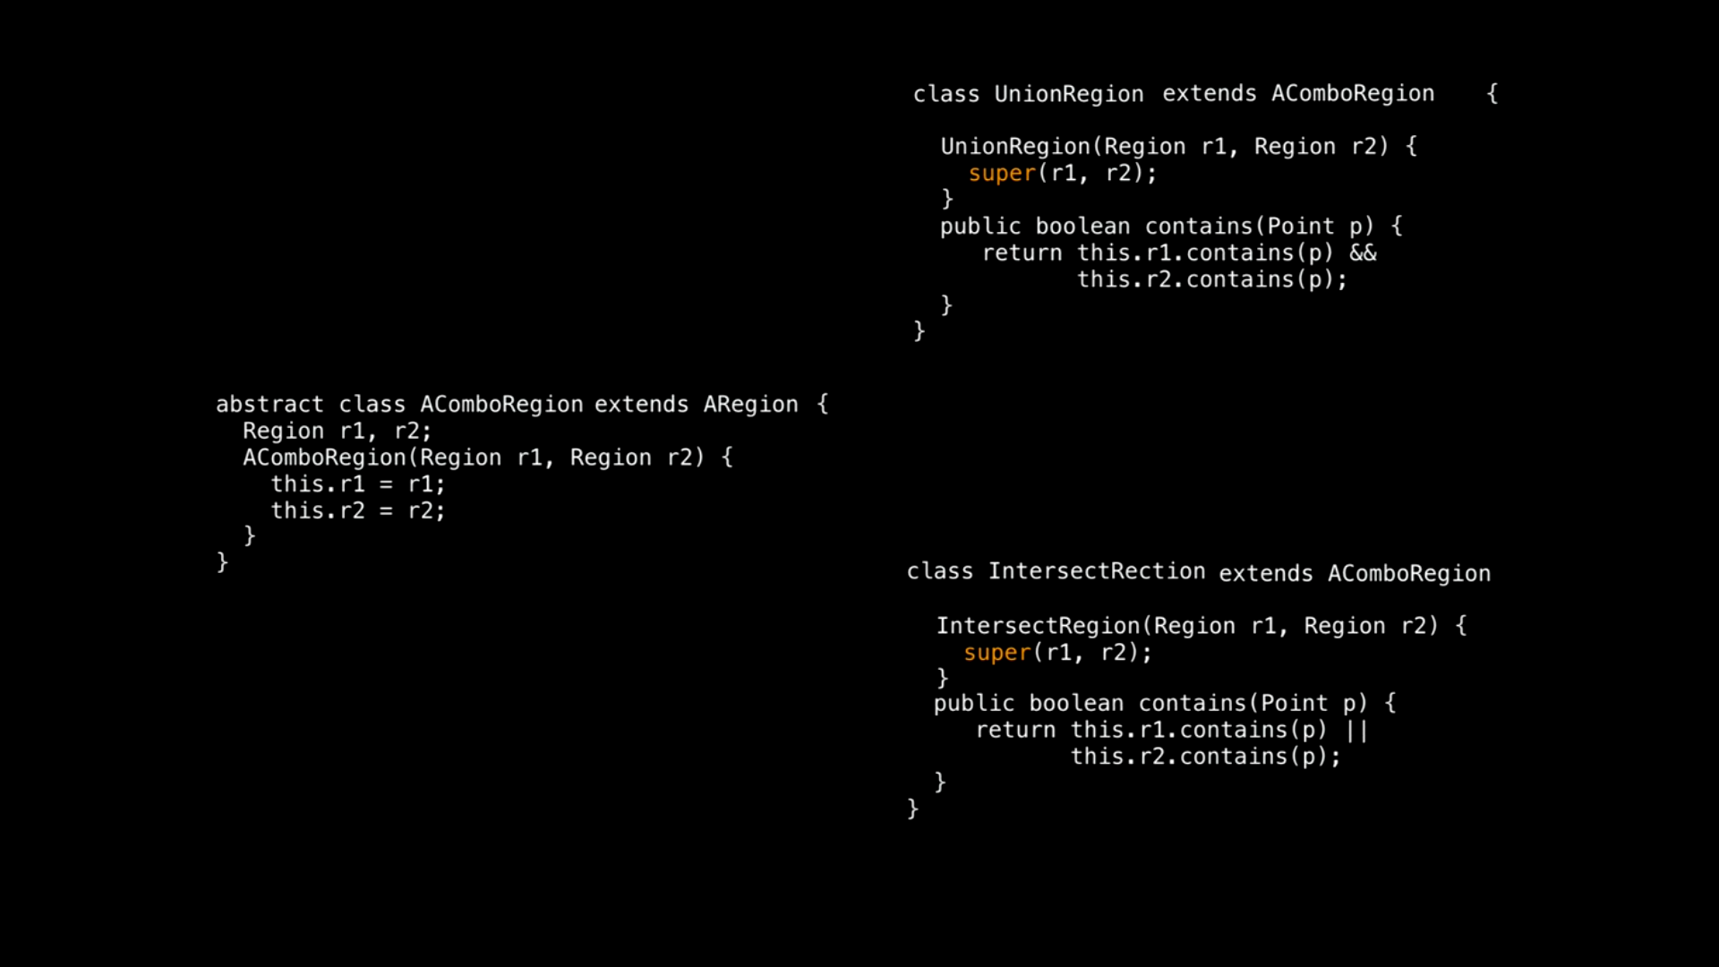



Slide 26
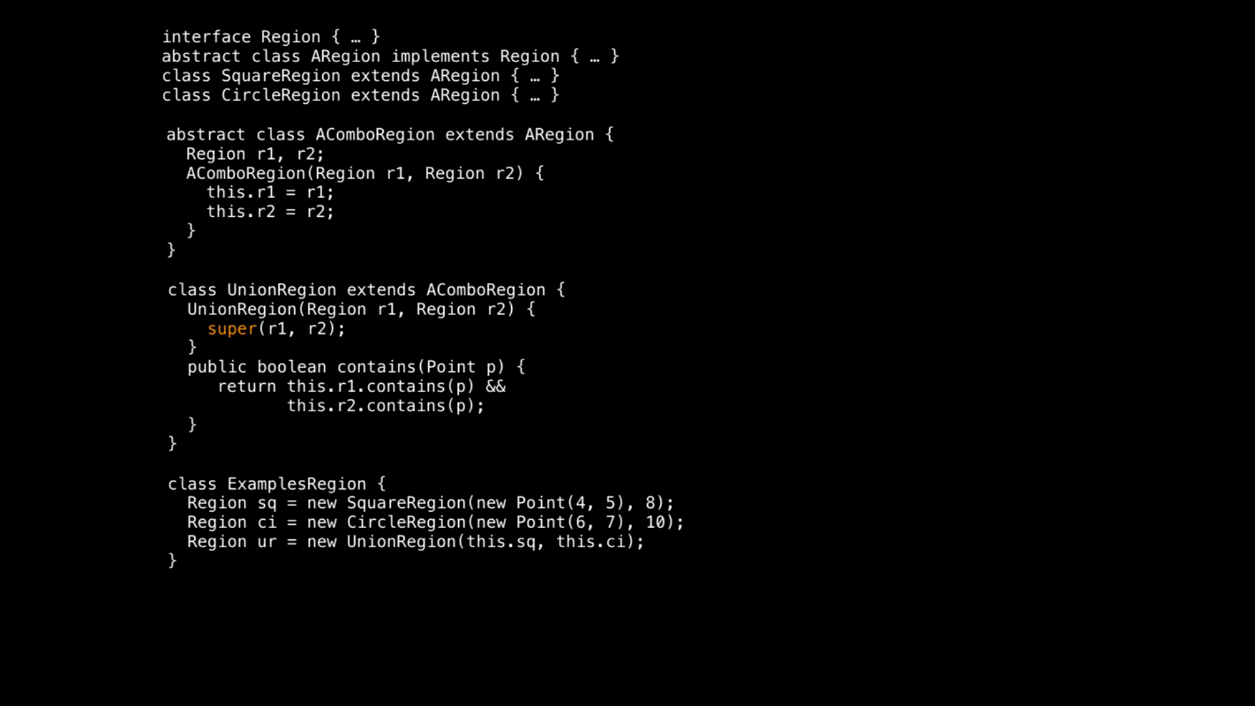

Slide 27
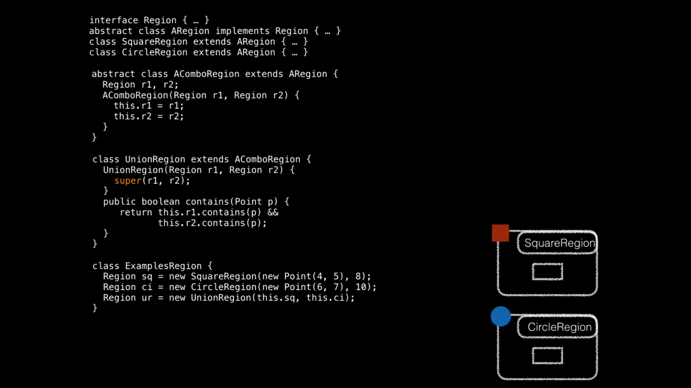

Slide 28
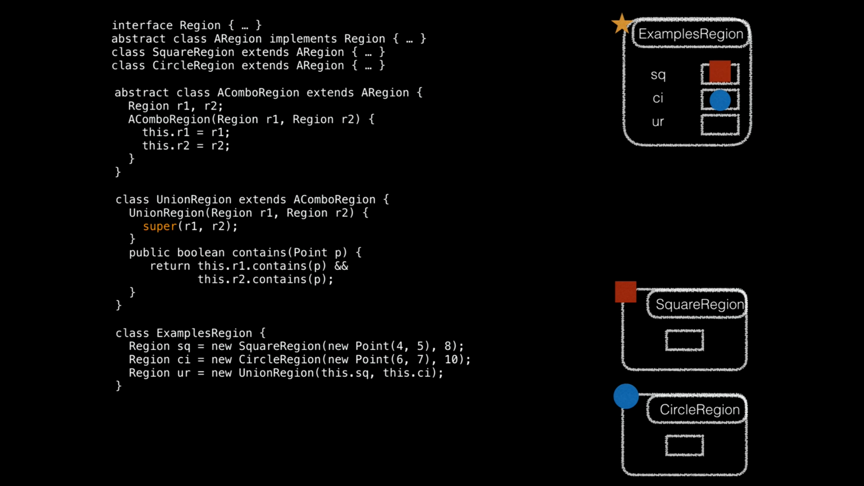

Slide 29
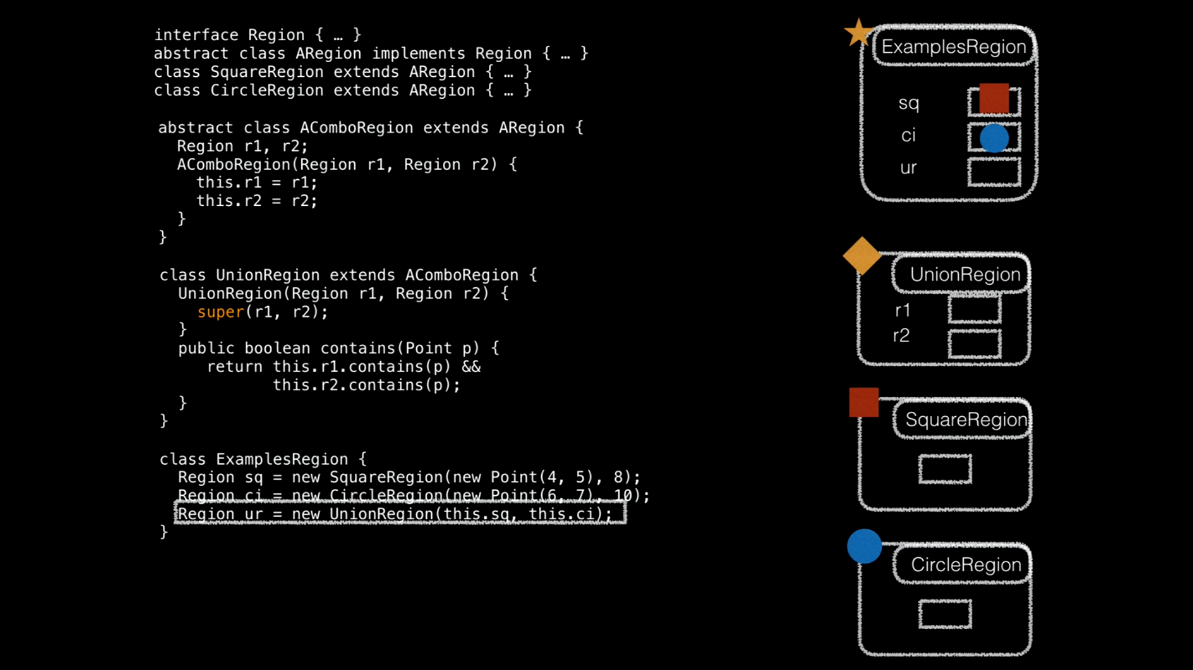

Slide 30
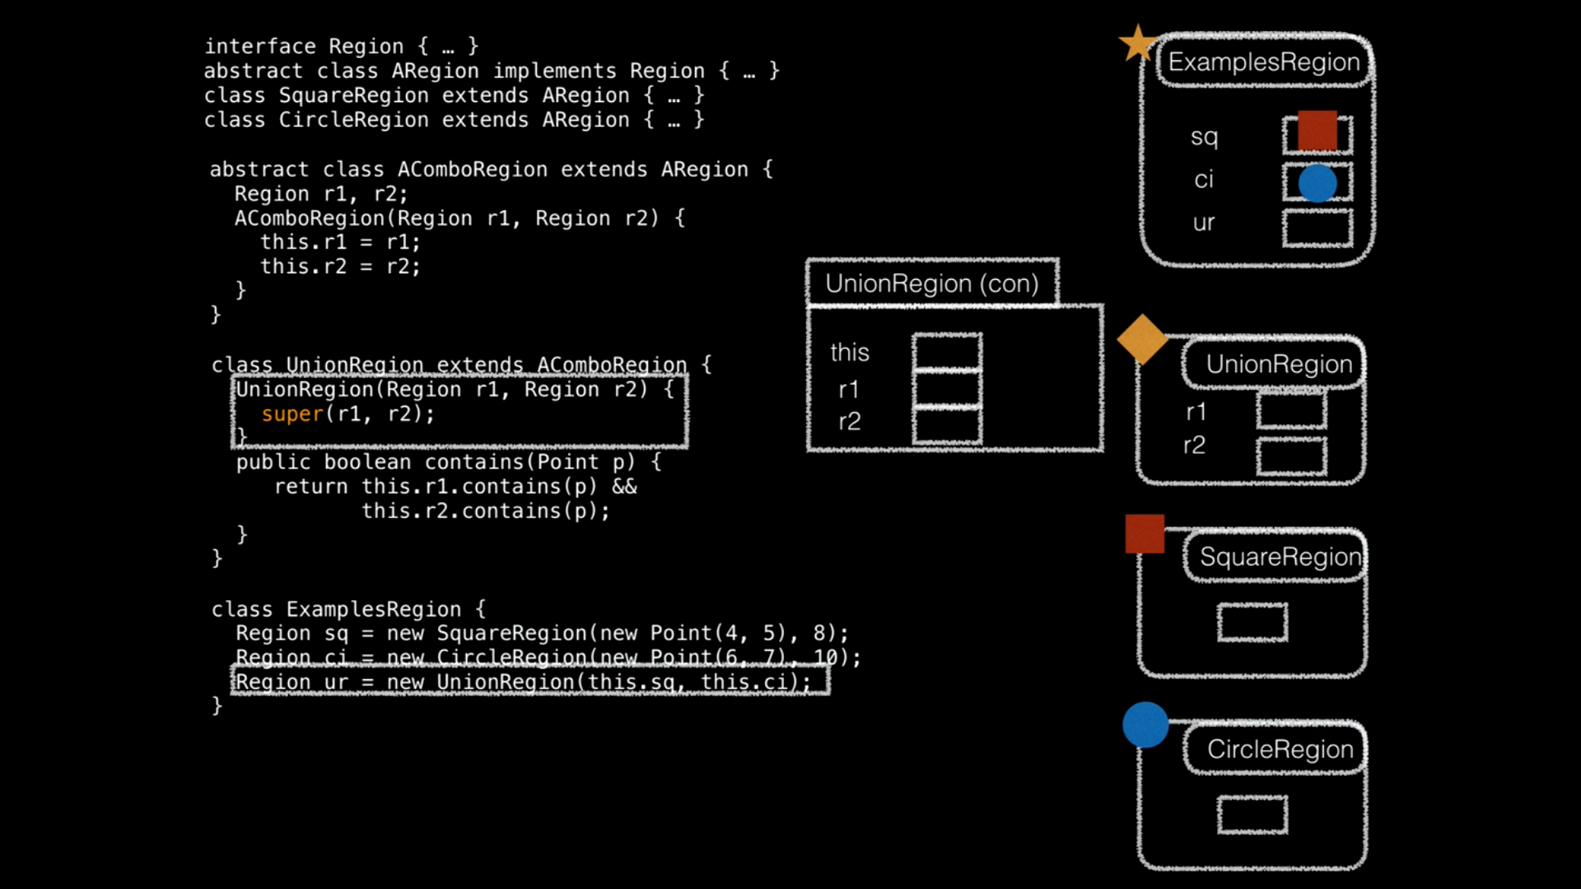

Slide 31
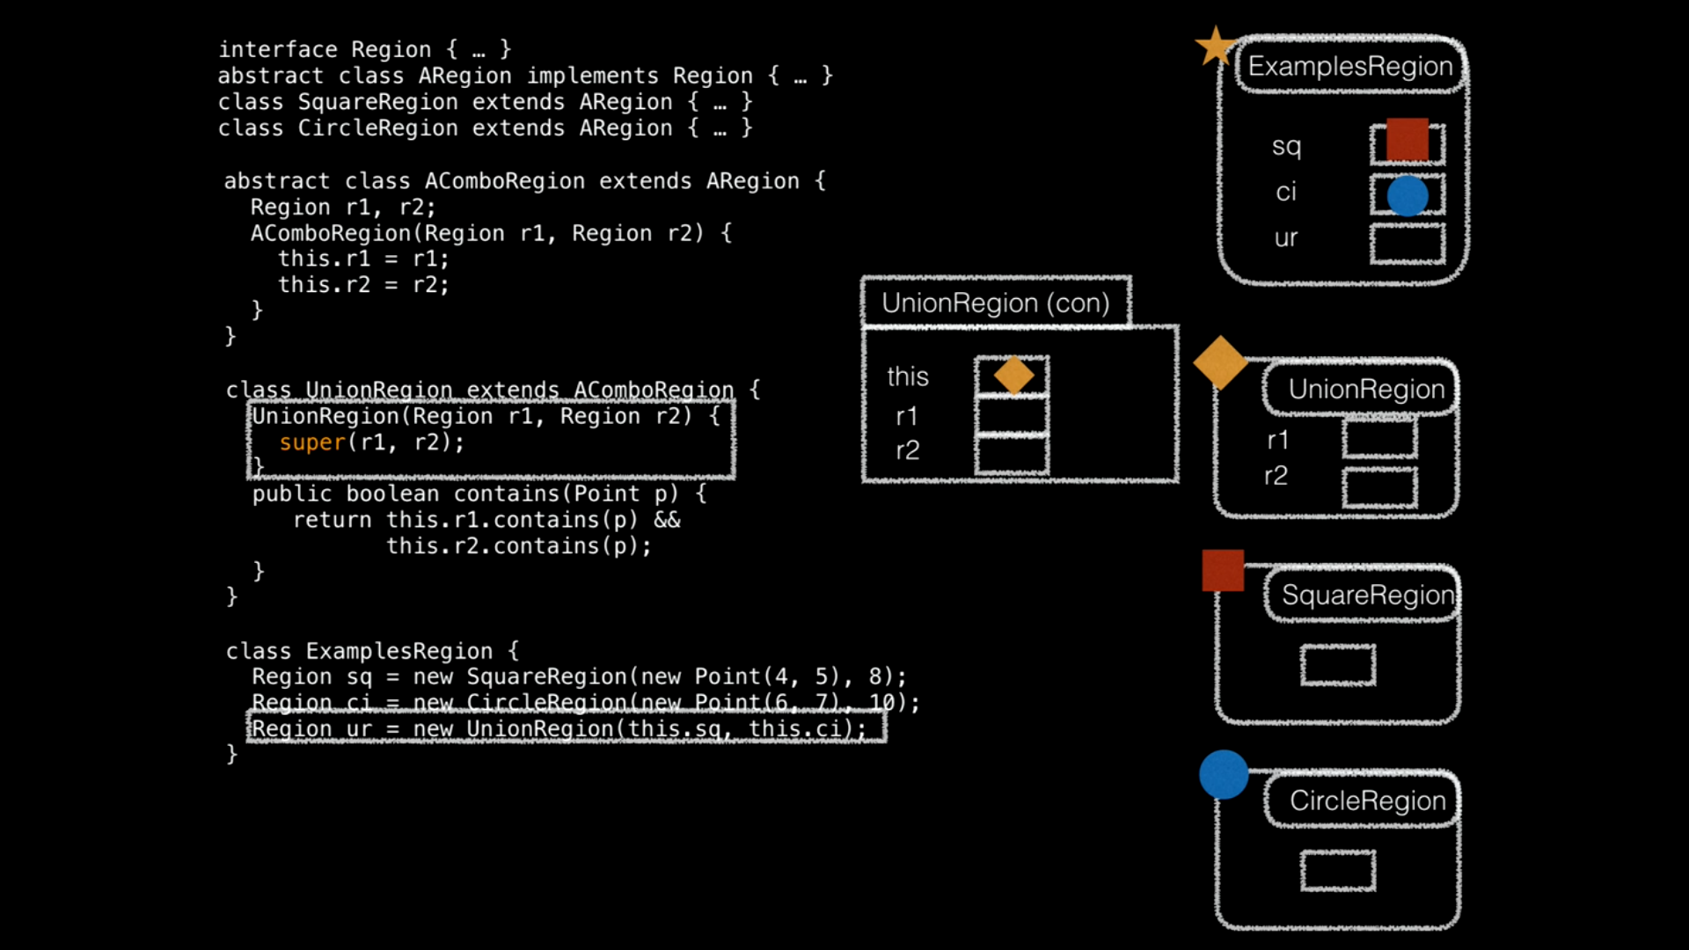

Slide 32
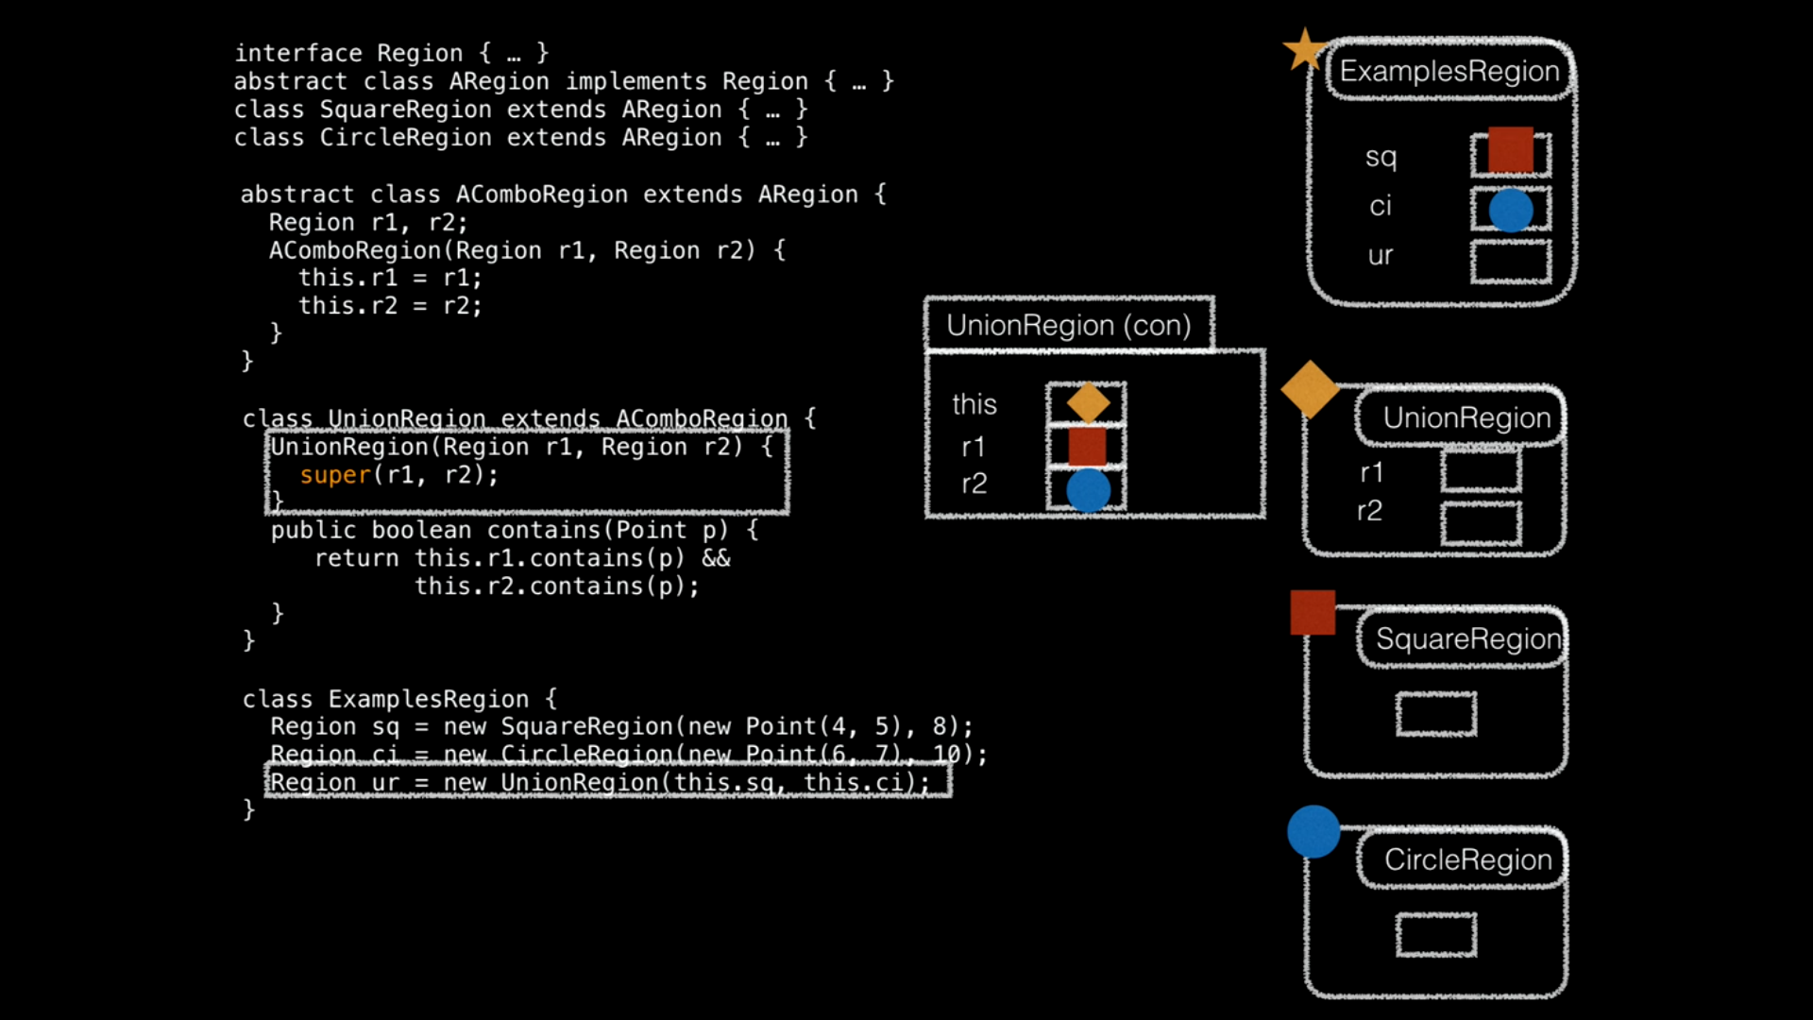

Slide 33
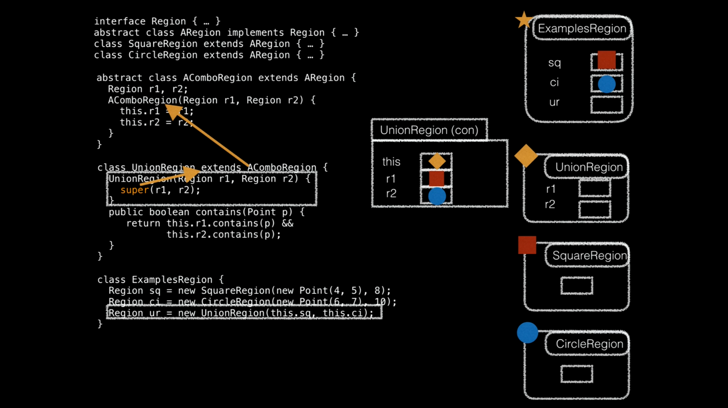

Slide 34
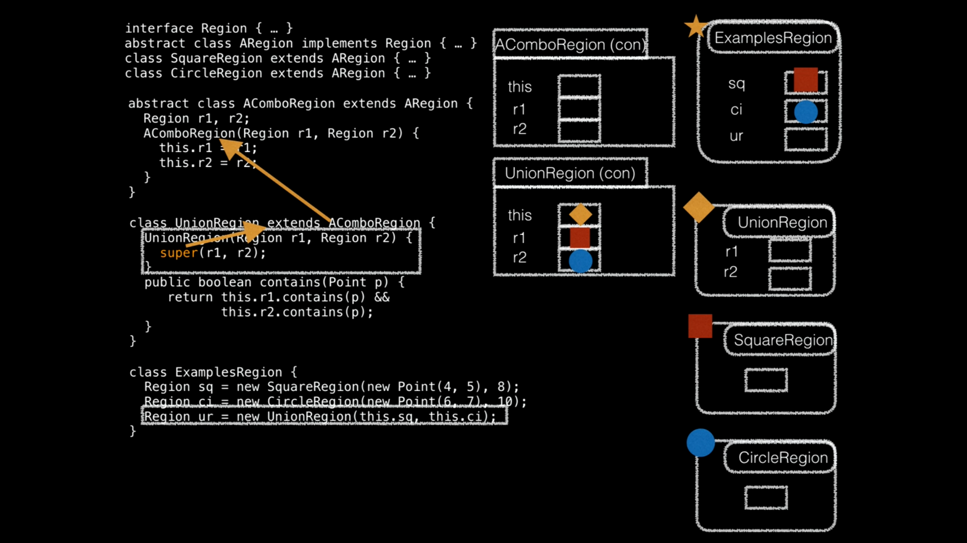

Slide 35
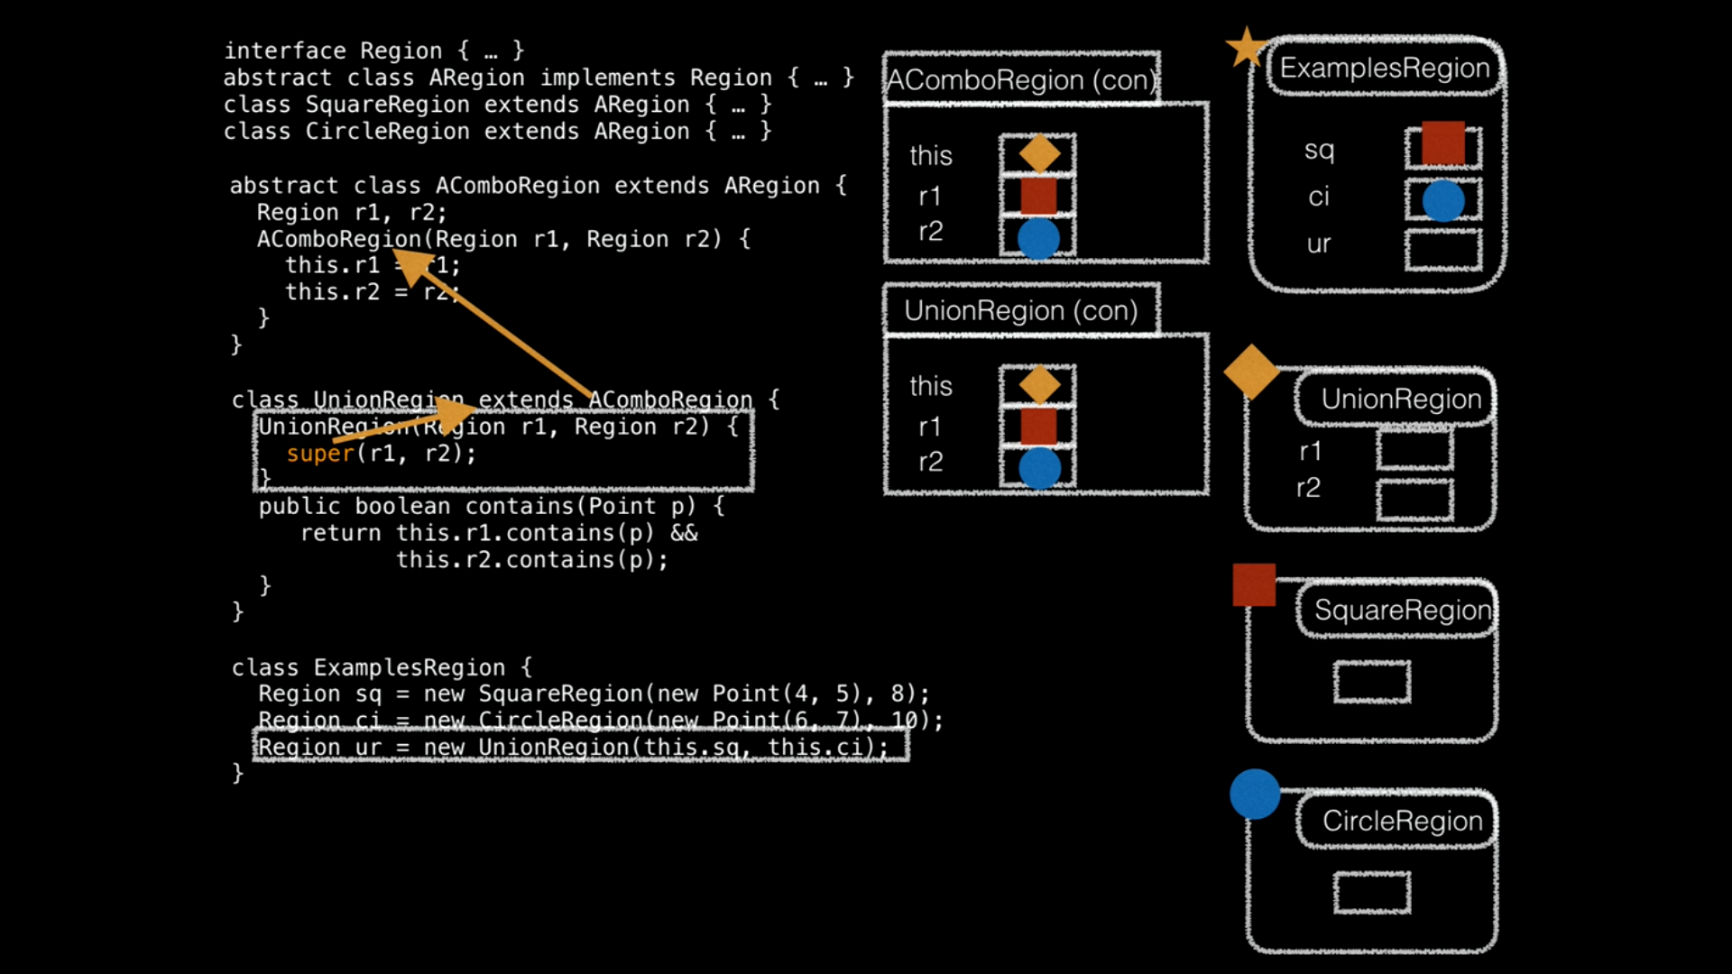

Slide 36
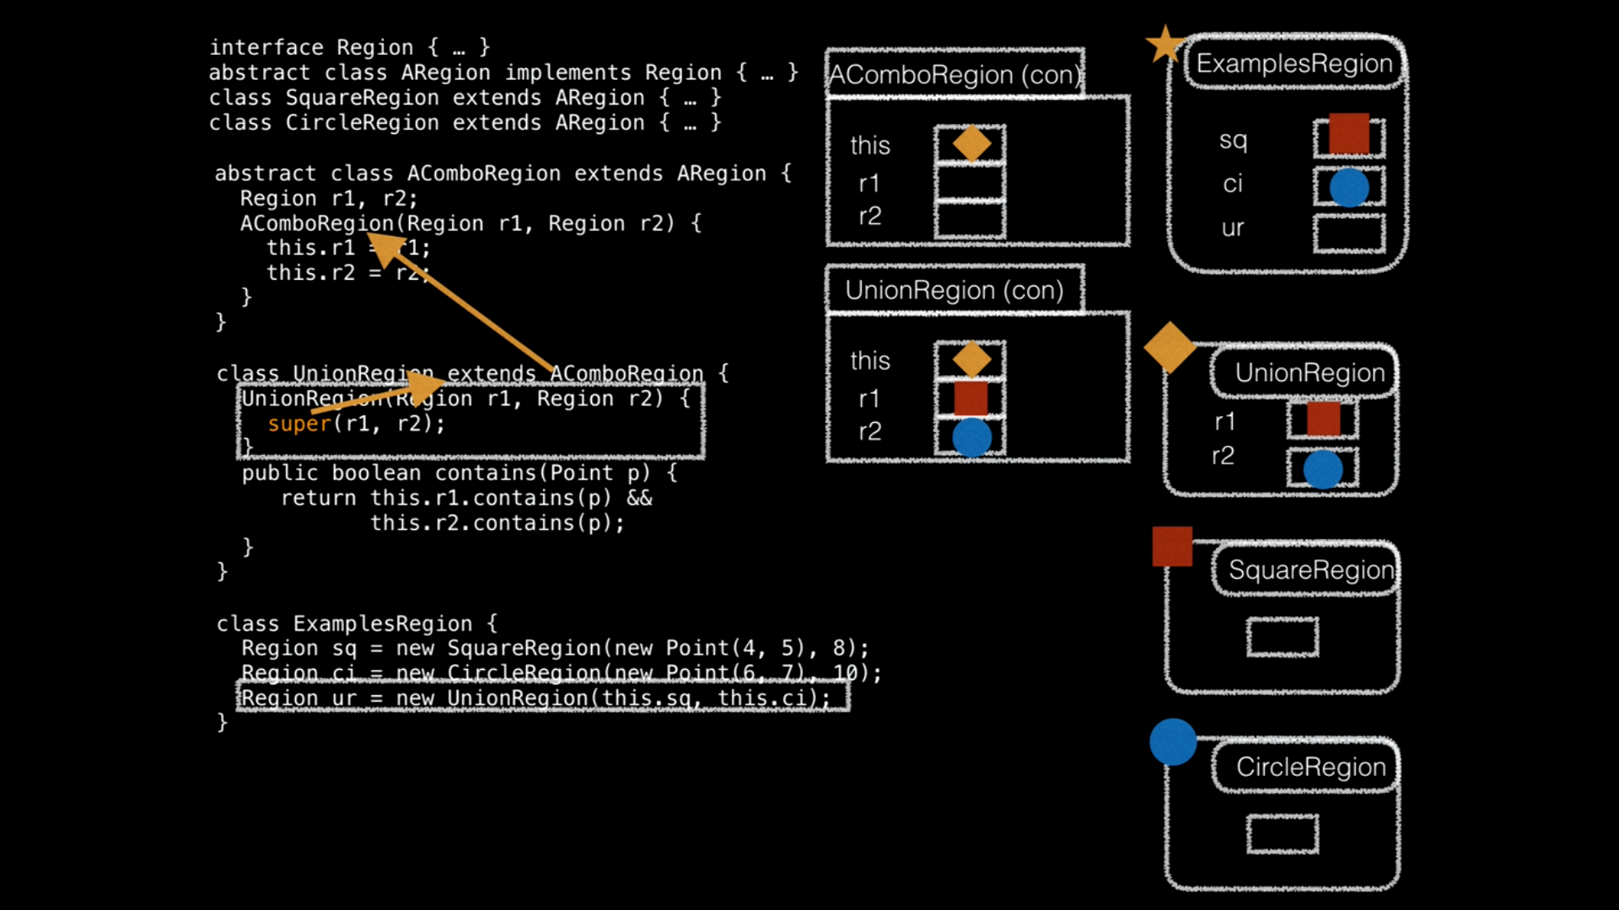

Slide 37
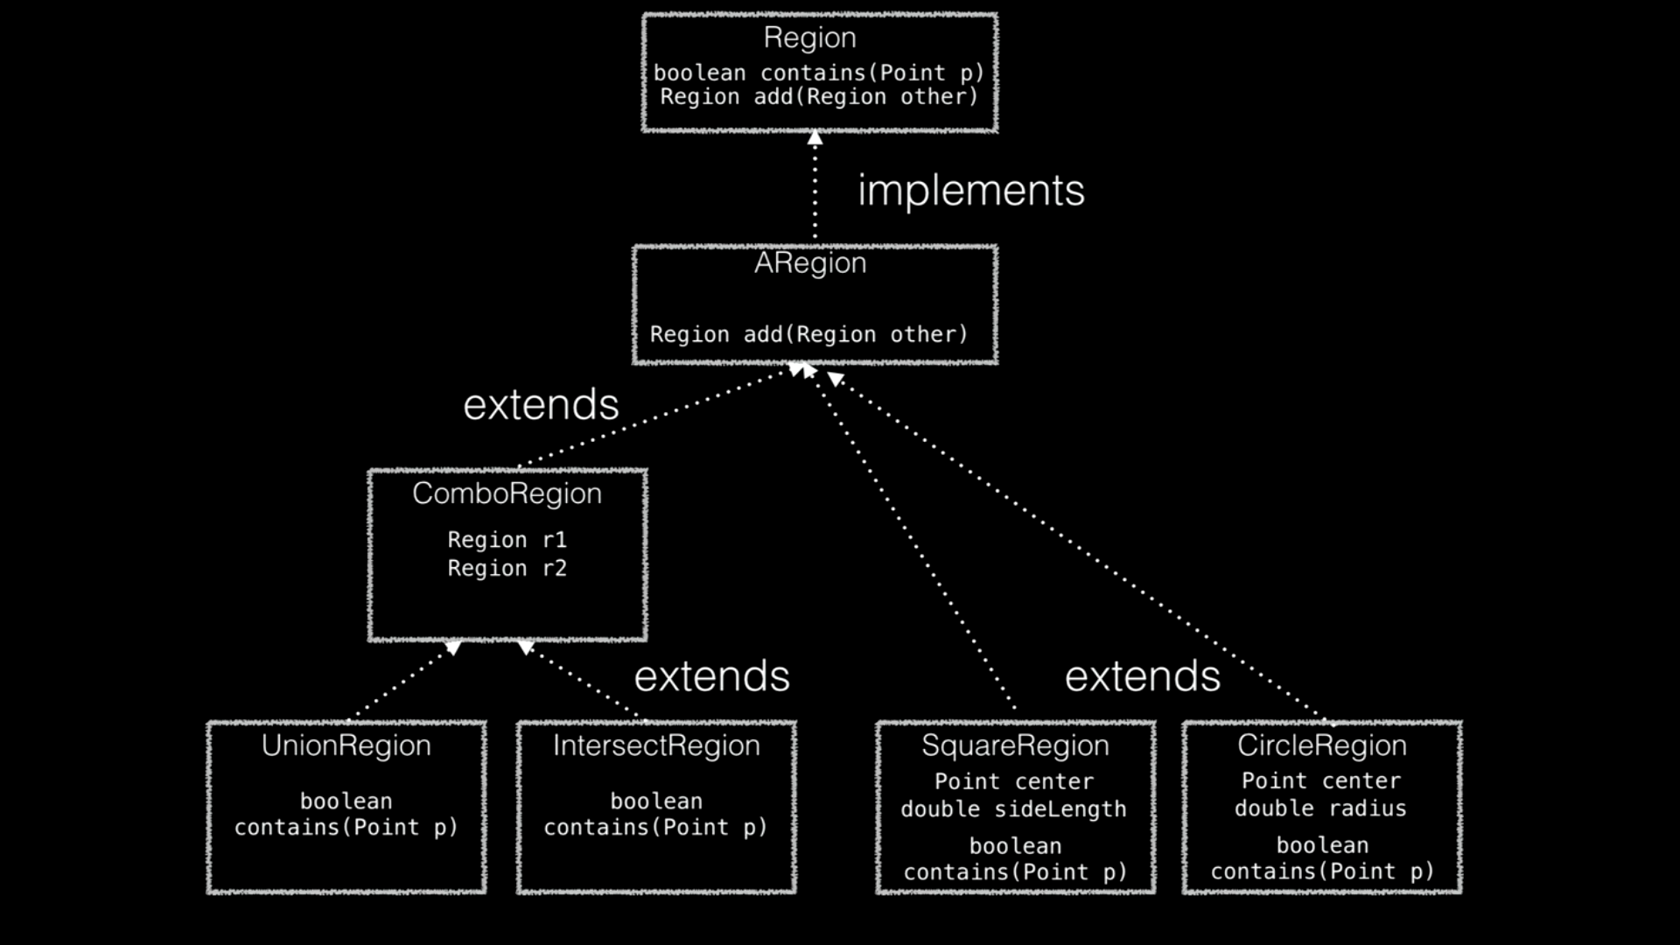

Slide 38
